Slide 1
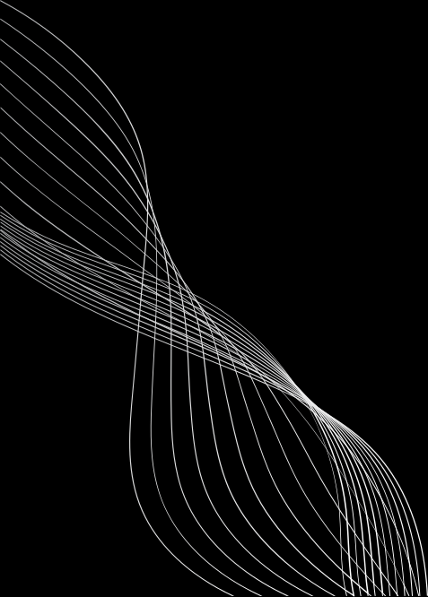


Interactive portfolio using html css and javascript
STUDENT NAME:NISHANTHI.A
REGISTER NUMBER AND NMD:ASTVU35635624U09030
DEPARTMENT:BCA 2ND YEAR
COLLEGE: GASC/THIRUVALLUR UNIVERSITY

Slide 2
PROJECT TITLE
INTERACTIVE PORTFOLIO USING HTML,CSS AND JAVASCRIPT

Slide 3
AGENDA
1.PROBLAM STATEMENT
2.PROJECT OVERVIEW
3.END USERS
4.TOOLS AND TECHNOLOGIES
5.PORTFOLIO DISIGN AND LAYOUT
6.FEATURES AND FUNCTIONALITY
7.RESULTS AND SCREENSHOT S
8.CONCLUSION
9.GITHUB LINK

Slide 4
PROBLEM STATEMENT
MODERN SOFTWARE COMPANIES FACE
CHALLENGES SUCH AS:
•
SLOW SOFTWARE DELIVERY DUE TO MANUAL DEPLOYMENTS
•
HIGH IN FRASTUCTURE COSTS WITH POOR
RESEARCH UTILIZATION
•
LACK OF AUTOMATION IN SCALING AND MONITORING SYSTEMS
•
COMPLEX MANAGEMENT OF MULTIPLE ENVIRONMENTS
(DEVELOPMENT, STAGING PROTECTION).

Slide 5
PROJECT OVERVIEW
AGEN A IS A PERSONAL CLOUD& DEVOPS:
PORTFOLIO SYSTEM DESIGN TO:
•
SHOW CASE REAL-WORLD DEVOPS WORKFLOW(CL/CD PIPELINE,
CONTAINERISATION, MONITORING).
•
DEMONSTRATE CLOUD INFRASTRUCTURE AUTOMATION
(AWS,AZURE,GCP).
•
PROVIDE HANDS-ON CASE STUDIES (E.G., DEPLOYING
MICROSERVICES, KUBERNETES CLUSTERS, SERVERLESS
APPS).
•
ACT AS AN INTERACTIVE RESUME FOR RECRUITERS
AND CLIENTS.

Slide 6
END USERS
•
THE PORTFOLIO TARGETS: RECRUITERS/ EMPLOYERS-
TO ACCESS TECHNICAL EXPERTISE IN DEVOPS& CLOUD.
•
CLIENTS/COMPANIES -TO EXPLORE SCABLE DEPLOYMENTS
SOLUTIONS.
•
PEERS&DEVELOPER-TO LEARN AND COLLABORATE
ON DEVOPS WORKFLOWS.

Slide 7
TOOLS AND TECHNIQUES
•
CLOUD PLATFORM:AWS, AZURE,GCP
•
CONTAINERZATION:DOCKER, KUBERNETES,OPENSHIFT
•
CI/CD RULES: JENKINS,GITHUB ACTIONS,GITLAB CI,CIRCLECI
•
VERSION CONTROL :GIT& GITHUB
•
SCRIPTING& AUTOMATION : PYTHON,BASH,POWERSHALL
•
HOSTING PLATFORMS:AWS EC2,LAMBDA,NOTLITY
VEREEL

Slide 8
POTFOLIO DESIGN AND LAYOUT
THE PORTFOLIO DESIGN FOLLOWS A PROFESSIONAL
DEVOPS SHOWCASE APPROACH
•
HOME PAGE: PROFILE INTRODUCTION WITH SKILLS SUMMARY .
•
•
ABOUT SECTION : CAREER OBJECTIVE AND DEVOPS PHILOSOPHY.
•
PROJECT SECTION:CASE STUDIES WITH:
•
PROBLEM STATEMENT
•
TOOLS USED
•
ARCHITECTURE DIAGRAM
IMPLEMENTATION STEPSOUTCOME

Slide 9
FEATURES AND FUNCTIONALITY
•
END TO END CI/CD PIPELINE INTEGRATION WITH GITHUB
•
ACTIONS OR JENKINS
•
KUBERNETES CLUSTER DEPLOYMENT AND SCALING DEMO
•
CLOUD COST OPTIMIZATION WORKFLOWS
•
MONITORING DASHBOARDS (PROMETHEUS AND GRAFANA
PROJECT SHOWCASE WITH ARCHITECTURE
•
DIAGRAM+SCREENSHOT
LIVE DEMOS HOSTED AN AWS /GCP/AZURE

Slide 10
RESULTS AND SCREENSHOTS
•
CI/CD PIPELINE RUNNING WITH SUCCESSFUL BLIND&
•
DEPLOYMENT LOGS.
TERRA FORM SCRIPT S CREATING AWS EC2,S3, AND
•
NETWORKING AUTOMATICALLY.
KUBERNETES PODS, SERVICE AND LOAD BALANCING
•
SCREENSHOTS
GRAFANA DASHBOARDS SHOWING SYSTEM
PERFORMANCE MATRICES.

Slide 11
CONCLUSION
AGEN A HIGHLIGHTS HOW A CLOUD & DEVOPS
ENGINEER CAN:
•
AUTOMATE DEPLOYMENT AND REDUCE MANUAL
EFFORTS
•
ENSURE SCALABILITY AND RELIABILITY WITH CLOUD
-NATIVE TOOLS.
•
MONITOR AND OPTIMIZE SYSTEM PERFORMANCE.
•
THIS PORTFOLIO ACTS AS BOTH A LEANING HUB
AND A RECRUITMENT -READY SHOWCASE FOR
DEVOPS EXPERTISE.

